Slide 1
From bottom to top

Slide 2
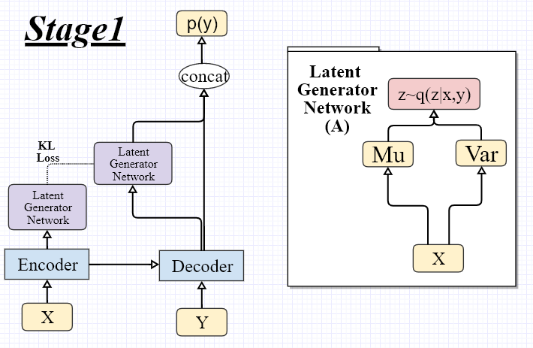
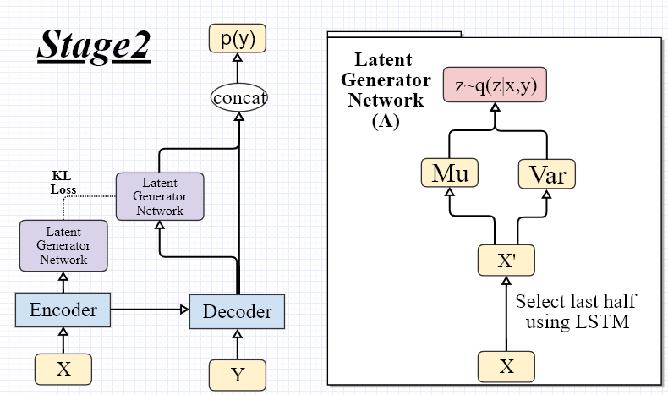

Slide 3
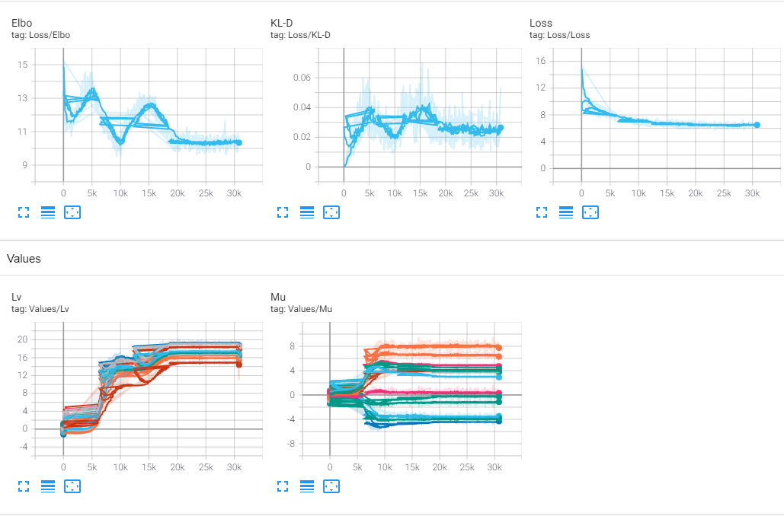

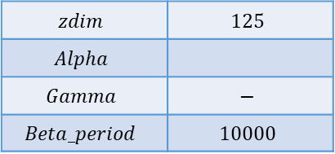
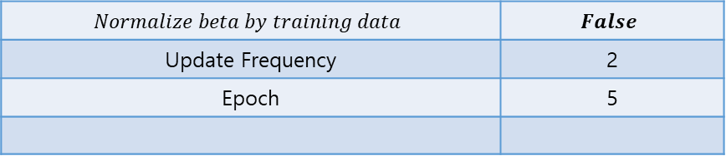
$Stage 1$
$$zdim$$ | $$125$$
$$Alpha$$
$$Gamma$$ | $$−$$
$$Beta_period$$ | $$10000$$
$$Normalize beta by training data$$ | $$False$$
Update Frequency | 2
Epoch | 5

Slide 6
Models

